Slide 1



MODULE 2: 6 TRUTHS OF SELLING
Here are the six truths that will never, ever change in the world of selling, no matter how much the landscape of sales may change:
Listening is the best personal skill a salesperson can ever master.
Failing to get in front of the real decision maker is a fatal error.
If you can close sales, you’ll never be successful as a salesperson.
Successful selling requires a significant level of skills in time and self-management.
Great salespeople are simultaneously both competitive and resilient.
Sales is all about presence and persuasion.

Slide 2


The 9 Sales You Must Make First
Here are the nine specific points on which you must sell yourself before you can expect to sell your product or service to any prospect.
If you’re not sold, no one else will be either.
If you have no prospects, you will fail.
Being trusted is more essential than being liked.
The sale is all in the questions.
Selling is about providing solutions.
You can minimize stalls, objections and delaying strategies.
Closing is not just using closes.
Promise a lot – and deliver even more.
You must master special situations.

Slide 3
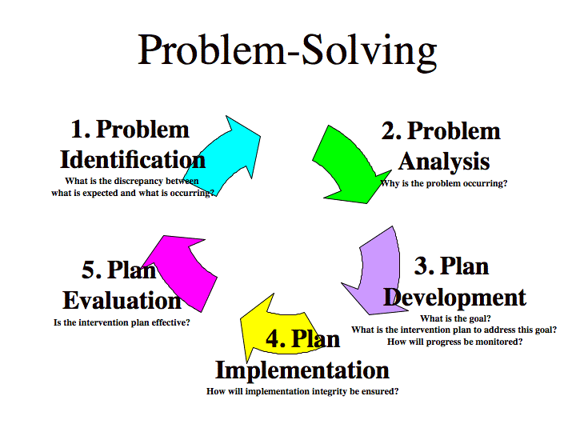

Direct Value Statement
Asking Good Questions
Good Listening: Face 2 Face

Slide 4




What Is Direct Value Statement?
What are the prospecting situations where you find yourself most often? They can likely be broken into the following categories:
Face-to-face, formally or informally
By telephone
At tradeshows
Through referrals from current customers
Through referrals from people other than customers
At networking events
In each of these situations you’ll need to know the importance and use of your own, one-of-a-kind Direct Value Statement(DVS).

Slide 5
Sample Direct Value Statement
We assist our clients/customers in the ……………………...industry to reduce personnel costs. We do this by offering screening and assessment services, hiring systems, and retention programs
We assist ……………………….(customers)……………………………..( industry or occupation) to…………………..(how you help). We do this by ……………………( your solution)

Slide 6
IMPACT Selling System: 6 steps in IMPACT process system
Investigate: prospecting, positioning, pre-call planning
Objective: to pre-call plan, position yourself properly, and gain a face-to-face appointment with a qualified prospect
Meet: building face-to-face trust and rapport
Objective: to set the face-to-face sales process in motion.
Probe: to have your prospect identify, verbalise, and discuss his/her needs, wants, and desires
Objective: to determine what, when, how, and why your prospect will buy your product
Apply: to show your prospect how your product will solve their problem, fill a need, or satisfy a want he or she has verbalized.
Objective: to recommend and present your product in a way that clearly matches the solution your prospect is trying to achieve.
Convince: to corroborate your claims.
Objective: to provide powerful social, statistical, or third-party proof of your claims:
Tie it up: to finalise the transactions, cement, and reinforce the sale.
Objective: to empower your prospect to buy, solidifying the sale, servicing, and vertically integrating the new account.

