Slide 1

Sales training
The 12 Realities of Selling
Six Truths of Selling
9 Sales You Must Make First
Direct Value Statement

Slide 2
Module I. The 12 Realities of Selling
1. The secret to selling is always in the continuous act of prospecting
Most salespeople fail because they lack a sufficient supply of qualified prospects. This means that you
“consistently, intelligently, and capably prospect for business no matter how long you have been selling”, it never stops; sales is always all about prospecting = FIRST REALITY

Slide 3

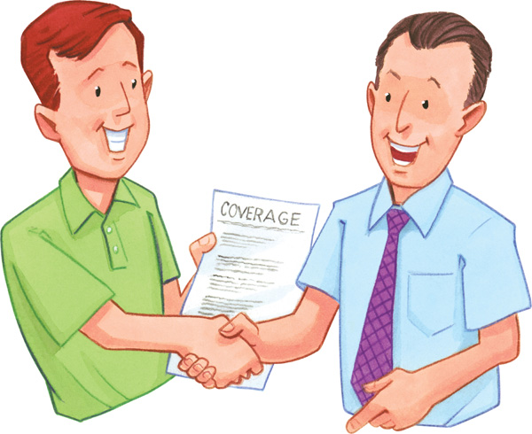
2. To sell successfully, You Must Be in Front of a Qualified Prospect When he /she is ready to buy, not when you need to make a sale = SECOND REALITY
It is about being the best and most viable available option among many that prospects seek when it comes time for them to make a purchase decision. There is a fundamental truth that they will make their buying decision on their time schedule, not yours. A major part of that secret is to invest your time intelligently and wisely. Don’t waste your time with unqualified prospects. You need to identify the most promising prospects expediently and efficiently fast and move beyond those who are not qualified= YOUR REAL ASSET IS TIME AND YOUR ONLY REAL ADVANTAGE IS HOW YOU INVEST YOUR TIME AND WITH WHOM YOU INVEST

Slide 4

3. You Must Position Yourself Correctly
You must position yourself, your organisation and your product in the mind of your buyer. You must DIFFERENTIATE what you do and how you do it from the rest of the pack=
THIRD REALITY
Short story about your company
What is your product/service?
What makes you different here come your USPs

Slide 5

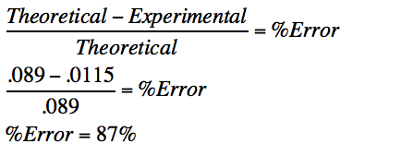
4. There Is Less Margin for Error
How to fix it?
You must always show up on time, fully prepared, equipped with thorough knowledge of your prospects, what they are trying to solve, how they function, how and why they make decisions, and much, much more. The essential point is all prospects have many options from which to choose and you are among those choices.
Therefore, you must not only be quick on your feet, but also have the SKILLS to apply your product or service, know exactly how to impart that knowledge to your prospect, and know how you can leverage his or her understanding of it to your best advantage= FOURTH REALITY

Slide 6
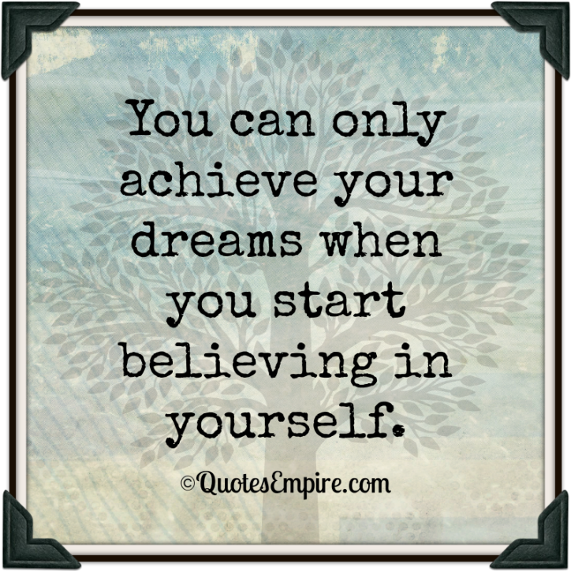
5. Prospect Must Believe You Have Something Important To Say
Prospect will grant appointments only to salesperson whom they perceive as having something important to say to them. Coming across as desperate or ill prepared will do nothing to help you maximize on this principle. On the other hand, knowing what to say, when to say it and precisely how to position yourself will allow you to put it on your side=
FIFTH REALITY

Slide 7
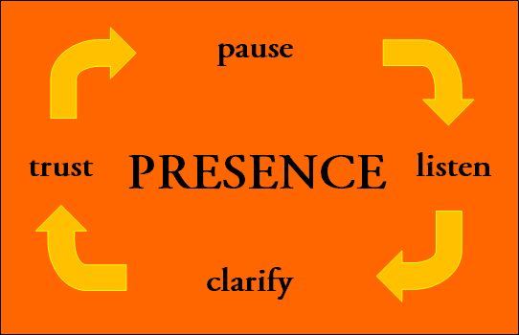
6. Being Trusted Is More Important Than Being Liked
All in all, a salesperson who is trustworthy and knows exactly how to demonstrate and communicate that trustworthiness in the very first transactional interaction with a prospect will outperform one who is just a smooth-talking flash in the pan at every turn= SIXTH REALITY

Slide 8

7. Prospects Are Busy
You need to know exactly how to get to the point of your presentation with the greatest speed of efficiency. To move from small talk to positive, effective sales talk with confidence, trust, and ease. KEEP IT SIMPLE ( KIS)=
SEVENTH REALITY

Slide 9
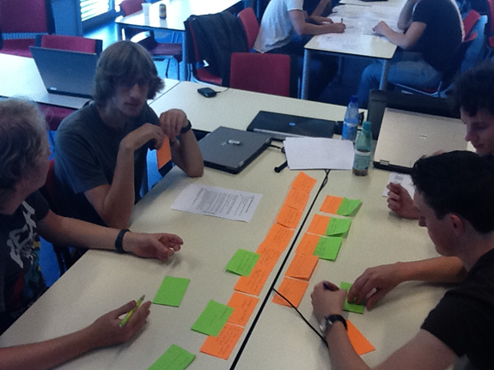
8. Prospects Will Buy to Solve Their Problems, Not Yours
To make a sale, earn a commission, win a contest, earn bonus, keep your job, pay your bills, get a promotion, or look good to other people.
The trust is that none of these have anything to do with their problem! What might be their problem?
To achieve greatest efficiency
Make money or a profit,
Keep their job,
Fix something that’s broken,
Enhance their organisation or,
Solve whatever your product or service helps them solve=
EIGHTTH REALITY

Slide 10

9. Prospects Will Try to Make Your Product a Commodity
Why will they do that? Because in the world of commoditisation, price always rules. Prospects are always trying to get the best price. Therefore, if they can reduce whatever product or service you sell to being a commodity, they’ll win! To do that, you must know exactly what, when, and how to deal with it. You need to be prepared to handle “ I can get the same thing down the street”- handle it well=
NINTH REALITY

Slide 11
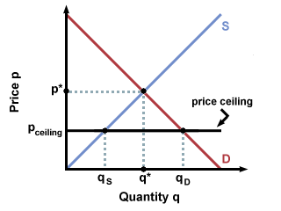
10. Prospects Will Want the Price Before You Want to Give It
Premature price questions are far more the rule than the exception. And, once you offer a price either verbally or in writing, that is likely the only thing your prospect will remember about your product or service!
If you offer it too soon you will not have created value. Why? Because you have not shown how you can satisfy a want, fulfil a need, solve a problem, or resolve an issue.
On the other hand, if you withhold too long or too clumsily, you’ll run risk of alienating your prospect and creating an adversarial relationship= TENTH REALITY

Slide 12
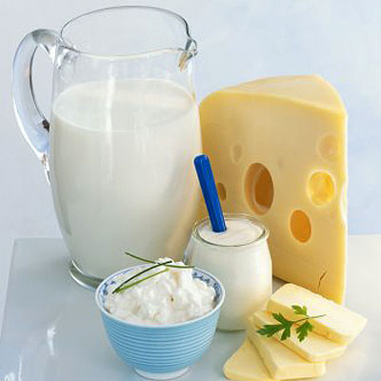
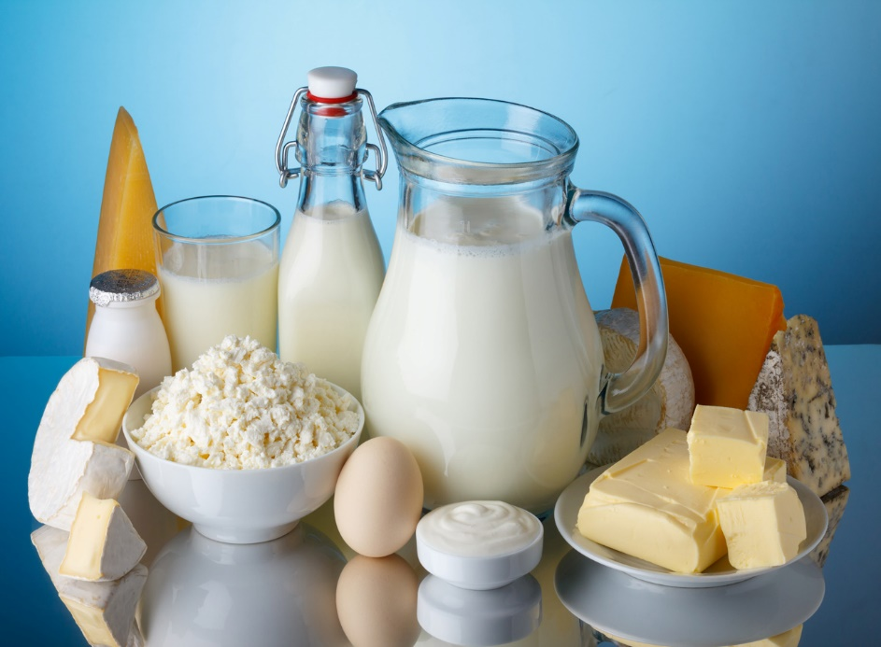
11. Establish the Value or It’s All About Price
Salesperson (including you) cannot presume that prospects perceive, understand, and comprehend the value of any offering without having it first interpreted for them. Price is such a dominant factor in today’s crowded marketplace that the value you deliver must be so clear in the mind of the buyer that it supersedes his or her drive to seek a progressively lower and lower price=
ELEVENTH REALITY

Slide 13
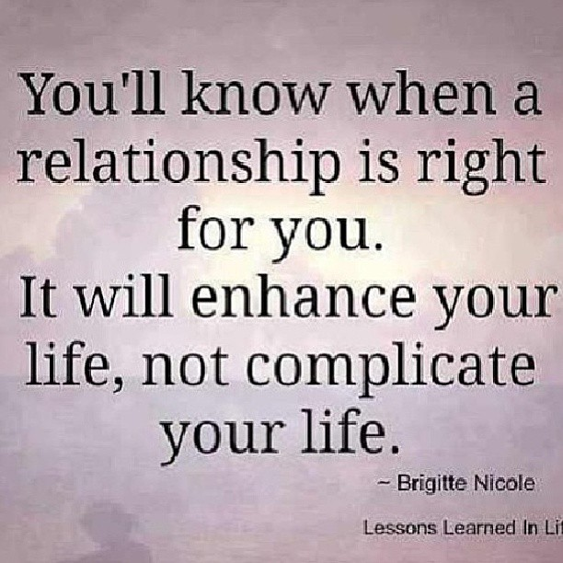
12. Relationship Has Changed
Customers are not as loyal as they used to be. Couple of that with younger and younger buyers coming into the marketplace who have learned to define relationships in terms of text messaging and internet communications and the impending changes promise to be cataclysmic for the unprepared.
Those factors, the constant pressure to compare prices, and services into the marketplace on a wholesale basis all merge to tell us that the terrain that defines relationships has truly been transformed forever= TWELVETH REALITY

Slide 14
CONCLUSION
Understanding these realities mean that your fundamental philosophy of sales may need to be modified, as well as the very words, exact phrases, and specific utterances that you have been using. Now let’s talk about 6 truths of selling

